Slide 1
Trees

Slide 2
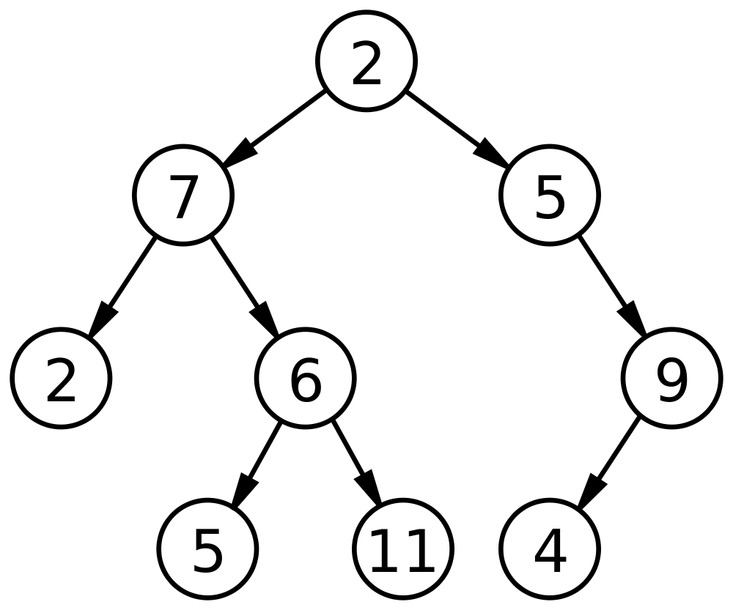
BINARY TREE
A binary tree is a tree data structure in which each node has at most two children, which are referred to as the left child and the right child.

Slide 3
A
A
B
C
B
D
E
F
G
C
H
I
D
E
The maximum number of nodes on level i of a Binary Tree is 2^{(i-1)}

Slide 4
A Binary tree is a non-linear data structure which is a collection of elements called nodes.
A Binary Search Tree (BST) is a Binary tree in which all the nodes follow the below-mentioned properties :
The left sub-tree of a node has a key less than or equal to its parent node's key.
The right sub-tree of a node has a key greater than to its parent node's key.
Thus, BST divides all its sub-trees into two segments;
Left sub-tree
Right sub-tree

Slide 5
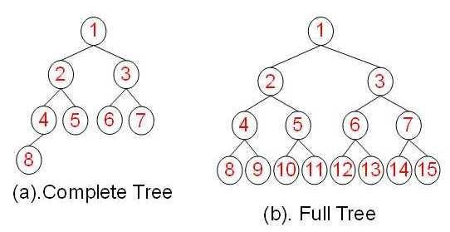
TYPES OF BINARY TREE
Complete Binary Tree:
In a complete binary tree every level, except possibly the last, is completely filled, and all nodes in the last level are as far left as possible.
Full Binary Tree:
A full binary tree (sometimes referred to as a proper or plane binary tree) is a tree in which every node has either 0 or 2 children.

Slide 6
Operations Performed in a BST:
Search − Searches an element in a tree.
Insert − Inserts an element in a tree.
Traversal :
Pre-order Traversal
In-order Traversal
Post-order Traversal
Traverses a tree in a pre-order manner. [Root->Left->Right]
Traverses a tree in an in-order manner. [Left->Root->Right]
Traverses a tree in a post-order manner.[Left->Right->Root]

Slide 7
Example:
Given : 37 ,24 ,45 ,20 ,29 ,41,52
37
24
45
20
29
41
52

Slide 8
Example:
Linked List Representation of Binary Tree
Given : 37 ,24 ,45 ,20 ,29 ,41,52
300
200 | 37 | 500
LEFT SUBTREE
RIGHT SUBTREE
200
500
800 | 24 | 1000
600 | 45 | 100
800
1000
600
100
NULL | 20 | NULL
NULL | 29 | NULL
NULL | 41 | NULL
NULL | 52 | NULL

Slide 9
BINARY TREE TRAVERSAL
Tree Traversal: Process of visiting (checking and/or updating) each node in a tree data structure, exactly once.

Slide 10
BINARY TREE TRAVERSAL
Tree Traversal: Process of visiting (checking and/or updating) each node in a tree data structure, exactly once.
Unlike linked lists, one-dimensional arrays etc., which are canonically traversed in linear order, trees may be traversed in multiple ways. They may be traversed in depth-first or breadth-first order.

Slide 11
BINARY TREE TRAVERSAL
Tree Traversal: Process of visiting (checking and/or updating) each node in a tree data structure, exactly once.
Unlike linked lists, one-dimensional arrays etc., which are canonically traversed in linear order, trees may be traversed in multiple ways. They may be traversed in depth-first or breadth-first order.
There are three common ways to traverse them in depth-first order: in-order, pre-order and post-order.

Slide 12
Preoder, Inorder, Postorder
In Preorder, the root is visited before (pre) the subtrees traversals
In Inorder, the root is visited in-between left and right subtree traversal
In Preorder, the root is visited after (pre) the subtrees traversals
Preorder Traversal:
Visit the root
Traverse left subtree
Traverse right subtree
Inorder Traversal:
Traverse left subtree
Visit the root
Traverse right subtree
Postorder Traversal:
Traverse left subtree
Traverse right subtree
Visit the root

Slide 13
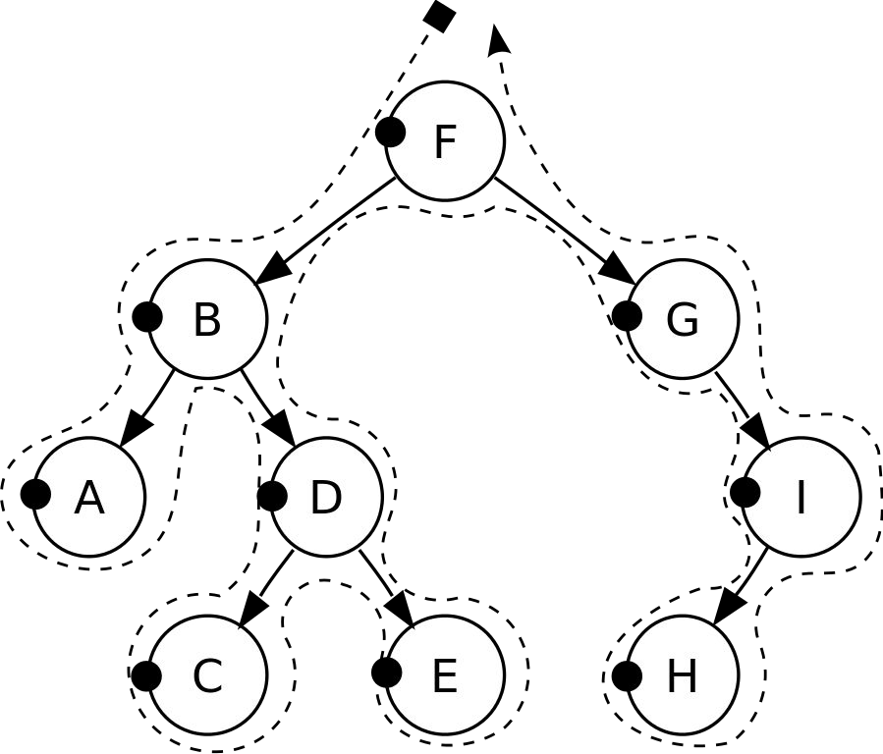
PRE-ORDER TRAVERSAL
Check if the current node is empty / null.
Display the data part of the root (or current node).
Traverse the left subtree by recursively calling the pre-order function.
Traverse the right subtree by recursively calling the pre-order function.
Pre-order: F, B, A, D, C, E, G, I, H.

Slide 14
PRE-ORDER TRAVERSAL
Visit ROOT Node First

Slide 15
PRE-ORDER TRAVERSAL
VISITED NODE
Visit LEFT Node

Slide 16
PRE-ORDER TRAVERSAL
VISITED NODE
VISITED NODE
VISITED NODE
Visit LEFT Node
VISITED NODE

Slide 17
a
PRE-ORDER TRAVERSAL
b
c
f
d
e
g
j
h
i
a
b
d
g
h
e
i
c
f
j

Slide 18
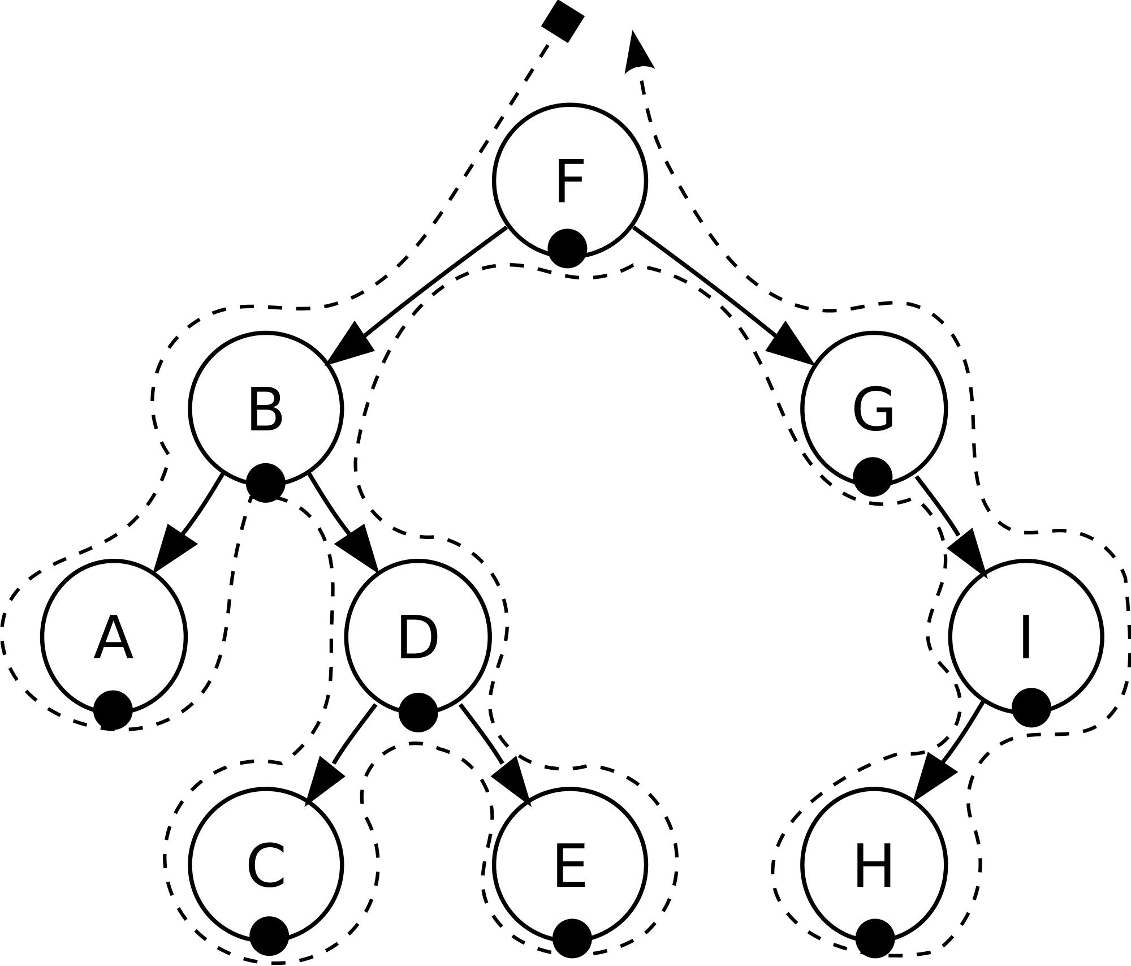
IN- ORDER TRAVERSAL
Check if the current node is empty / null.
Traverse the left subtree by recursively calling the in-order function.
Display the data part of the root (or current node).
Traverse the right subtree by recursively calling the in-order function.
In-order: A, B, C, D, E, F, G, H, I.

Slide 19
a
IN- ORDER TRAVERSAL
b
c
f
d
e
g
j
h
i
g
d
h
b
e
i
a
f
j
c

Slide 20

POST-ORDER TRAVERSAL
Check if the current node is empty / null.
Traverse the left subtree by recursively calling the post-order function.
Traverse the right subtree by recursively calling the post-order function.
Display the data part of the root (or current node).
Post-order: A, C, E, D, B, H, I, G, F.

Slide 21
POST-ORDER TRAVERSAL
A
B
C
F
D
E
G
J
H
i
G
H
D
I
E
B
J
F
C
A

Slide 22
Algorithm to Insert a new NODE
Algorithm insertNode(dataa, root )
{
//create a new node.
Node *temp := new Node;
temp->data := dataa;
temp->leftch := NULL;
temp->rightch := NULL;
if <root==NULL> then
root := temp;
else do
{
Node *current := NULL, *parent := NULL;
current := root;
while < 1 > do
{
parent :=current;
if <dataa is less than parent->data> then
{
current := current->leftch;
if <current==NULL> then
{
parent->leftch :=temp;
write "inserted to left ";
return;
}
}
}
}

Slide 23
else do
{
current :=current->rightch;
if < current==NULL > then
{
parent->rightch := temp;
write "inserted to right *";
return;
}
}
}

Slide 24
Algorithm to display a Binary Tree
Algorithm display(Node *ptr, level)
{
if < ptr!=NULL > then
{
display(ptr->rightch, level+1);
write "\n";
for < i = 0 to i is less then level >
printf(" ");
i++;
write ptr->data;
display(ptr->leftch, level+1);
}
}

Slide 25
Algorithm for Pre-Order Traversal
Algorithm Preorder( root )
{
// base condition for recursion (Root, Left, Right)
// if tree/sub-tree is empty, return and exit
if < root == NULL > then
return;
write root->data; // Print data
Preorder(root->leftch); // Visit left subtree
Preorder(root->rightch); // Visit right subtree
}

Slide 26
Algorithm for Post-Order Traversal
Algorithm Postorder(root)
{
if < root == NULL > then
return;
Postorder(root->leftch); // Visit left subtree
Postorder(root->rightch); // Visit right subtree
write root->data; // Print data
}

Slide 27
Algorithm for IN-Order Traversal
Algorithm In_order( root)
{
// (Left, Root, Right).
if < root == NULL > then
return;
In_order(root->leftch); //Visit left subtree
write root->data; //Print data
In_order(root->rightch); // Visit right subtree
}

Slide 28
Algorithm to Search a data in BST
Algorithm Search_Tree( root , data)
{
if < root == NULL > then
return ;
else
if < data == root->data > then
return root;
else
if < data is less then root->data > then
return Search_Tree(root->leftch, data)
else
return Search_Tree(root->rightch, data)
}

Slide 30
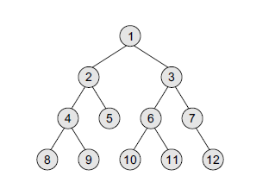

Slide 31
Algorithm to Delete a BST
Algorithm DeleteTree( root )
{
if < root ==NULL > then
DeleteTree(root->leftch)
DeleteTree( root->rightch)
free root
}

Slide 32
Algorithm to Find Smallest Node in a BST
Algorithm findsmallest( root )
{
if < root ==NULL or root->leftch==NULL> then
return root
else do
findsmallest(root->leftch)
}

Slide 33
Algorithm to Find Total Number of Node in a BST
Algorithm findsmallest( root )
{
if < root ==NULL > then
return 0
else do
return TotalNodes(root->leftch) + TotalNodes(root->righttch) + 1
}

Slide 34
Algorithm to Find Height of a BST
Algorithm Height_tree( root )
{
if < root ==NULL > then
write “NO TREE FOUND”
else do
leftheight = Height_Tree(root->leftch)
rightheight= Height_Tree(root->righttch)
if < leftheight is greater then rightheight > then
return leftheight +1
else
return rightheight +1
}

